Slide 1
Ask Weber
Session 2
Topic 4
https://askweber.github.io/

Slide 2
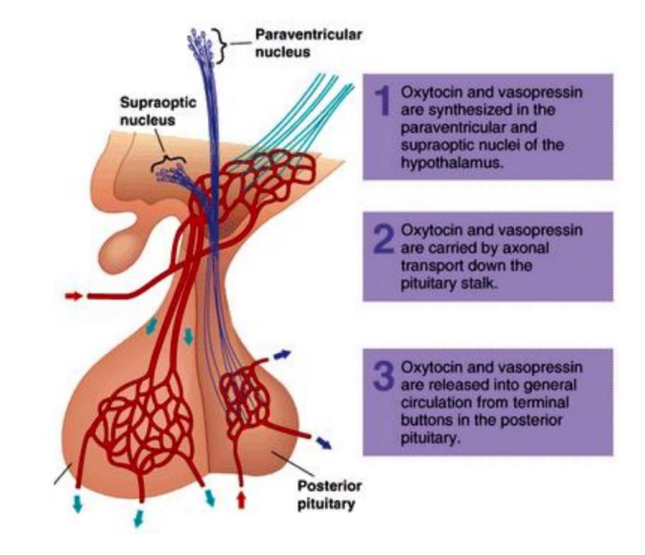

Lecture 5 – Feedback loops
Identify the hormones released by the anterior pituitary and the posterior pituitary
Which hormone(s) are synthesized by the neurons whose cell bodies are located within the supraoptic nucleus of the hypothalamus?

Slide 3
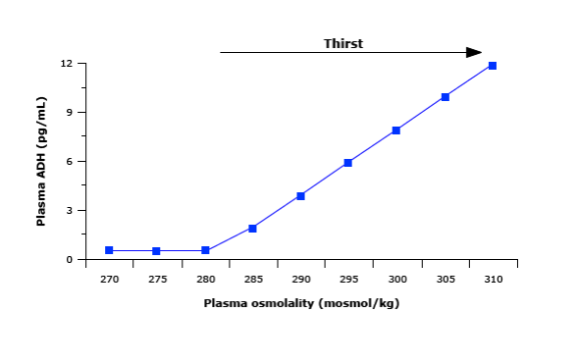
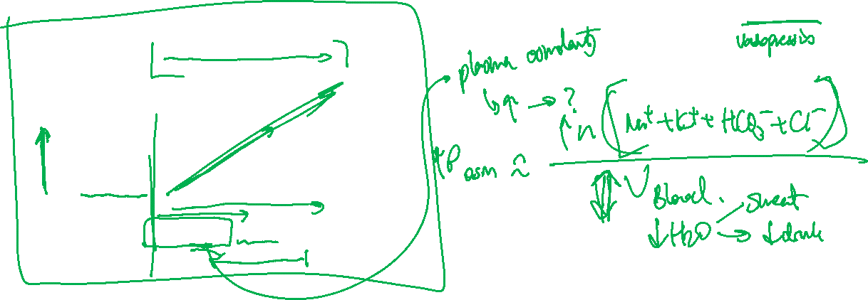
Lecture 5 – blood osmolarity feedback
Describe the figure to the left and explain one main stimulus which will result in an increase in plasma ADH.

Slide 4
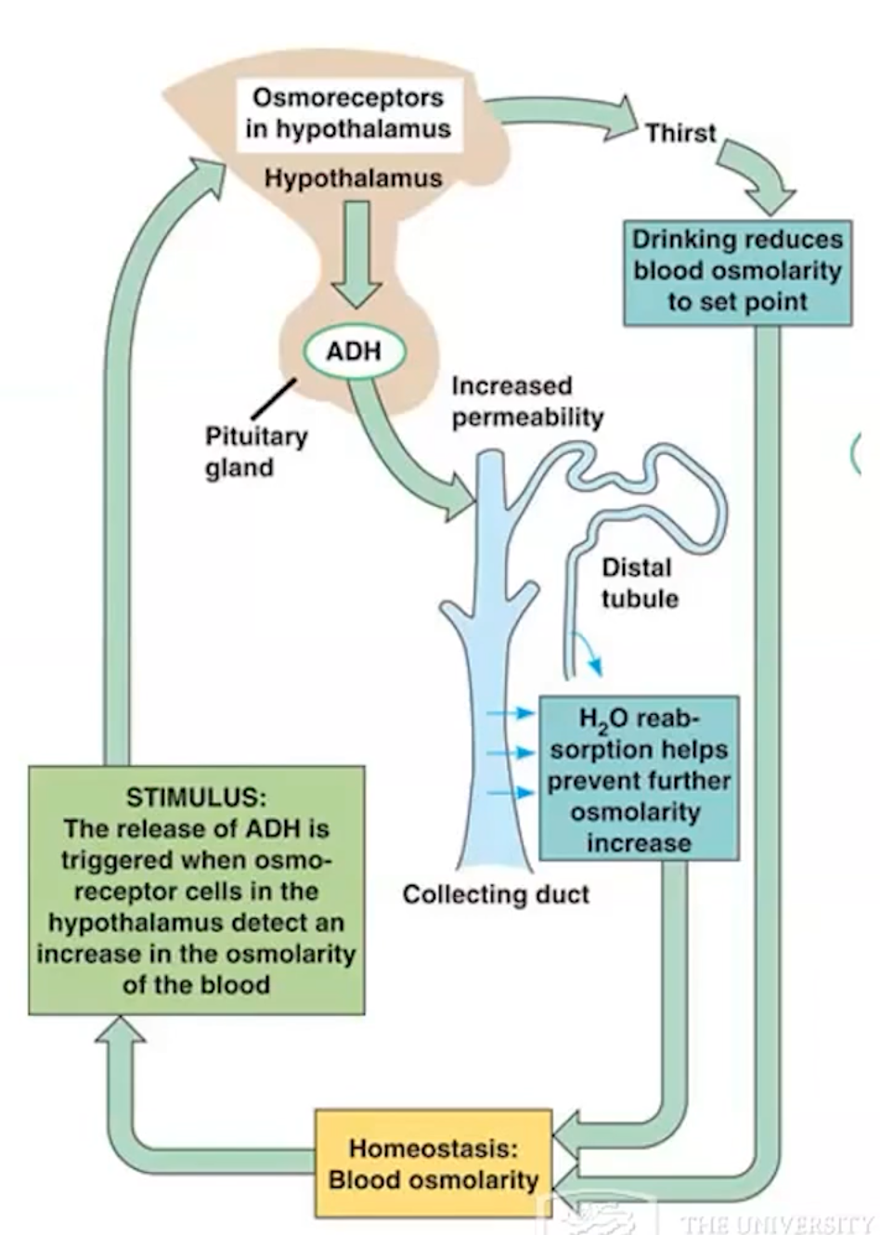
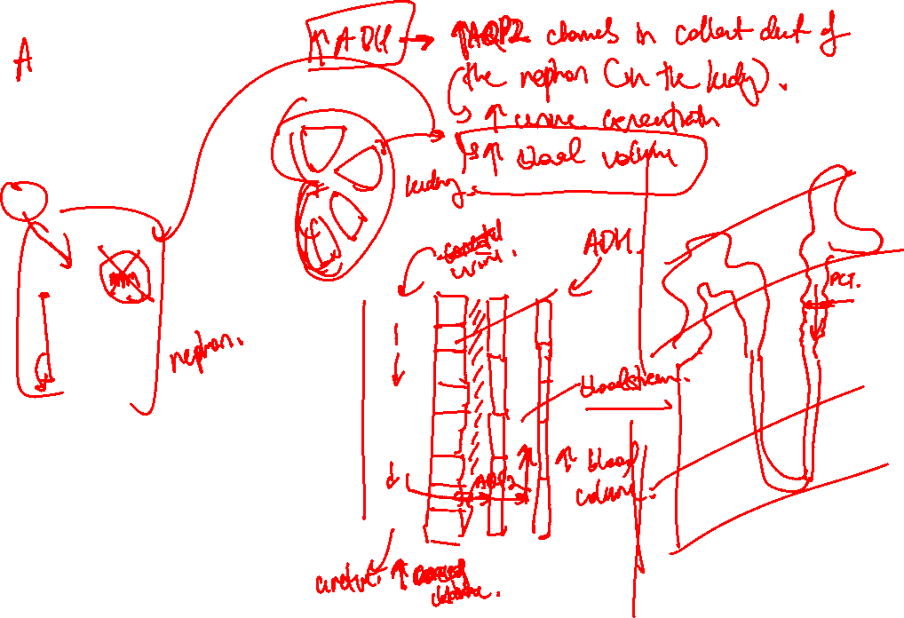

Slide 5
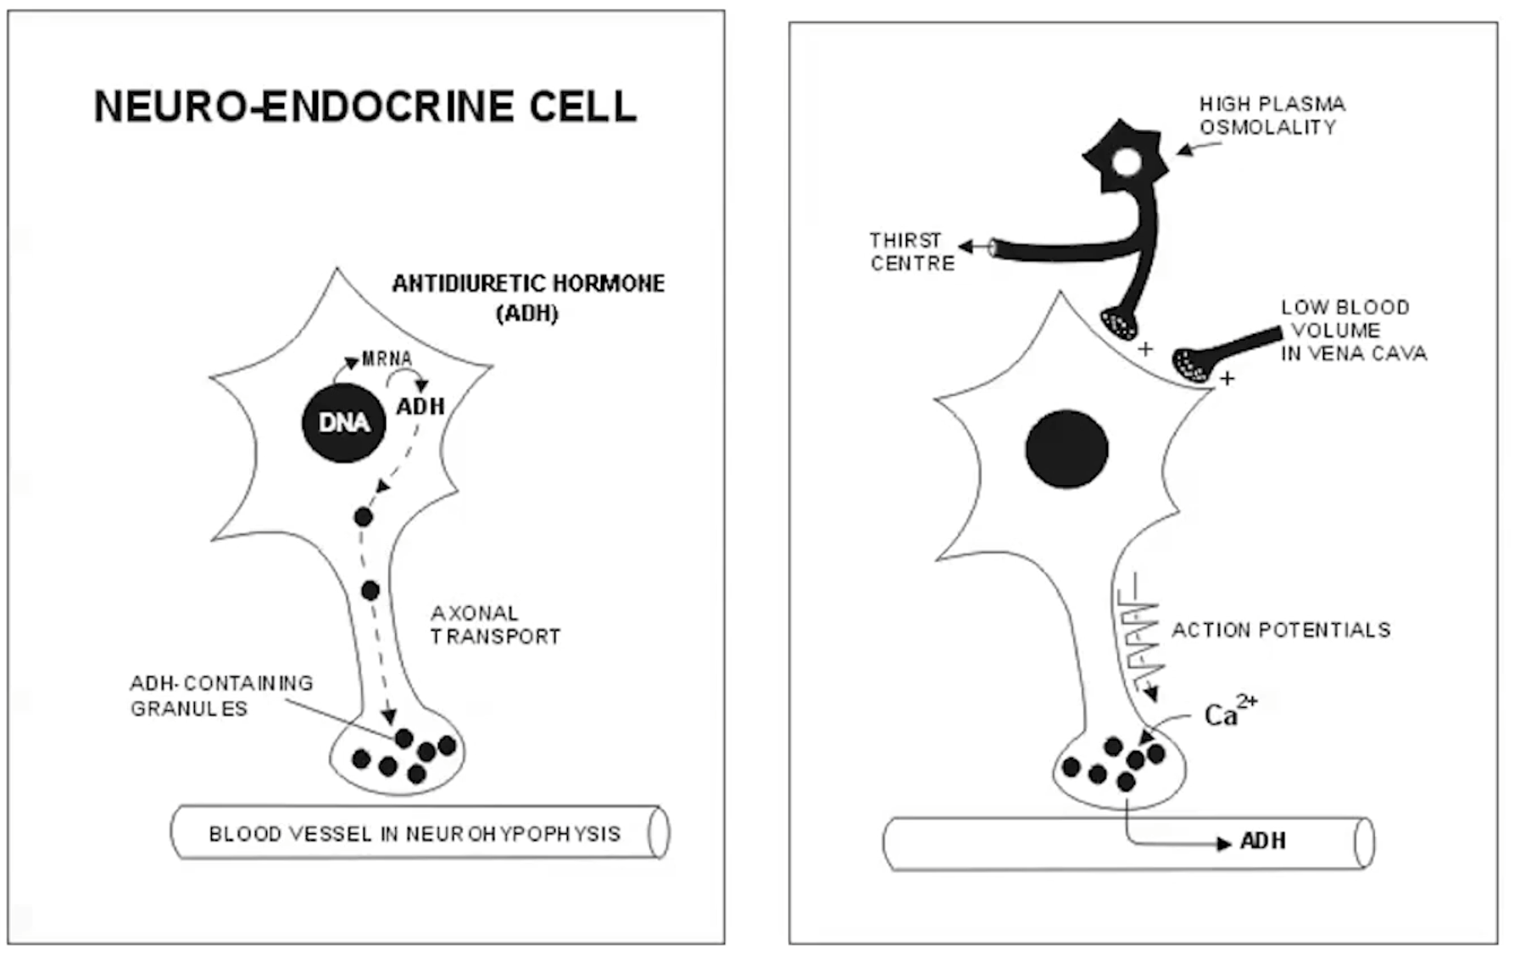
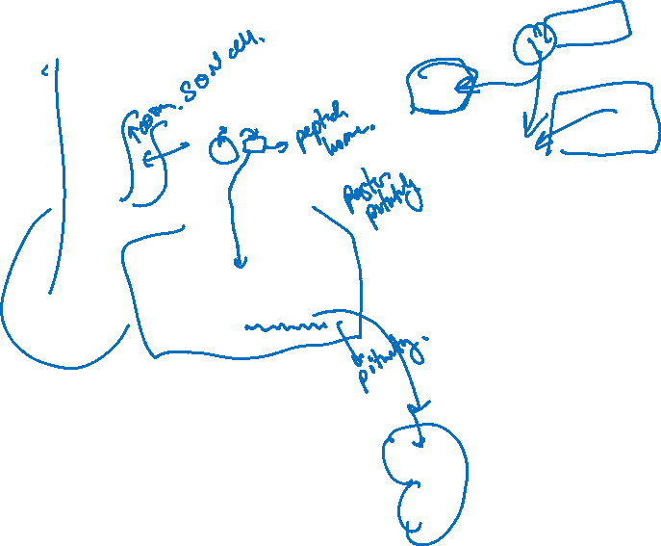

Slide 6
END
Random notes after

Slide 7
Cell to cell 1
Nervous
Endocrine
Bloodstream
Homeostasis
Organ
HPA axis, HPG axis
Exocrine
Hormone
Reproduction, growth, development – TH, GH, prolactin, LH, FSH
Maintenance of internal environment – PTH, Aldosterone
Energy production,utilization, storage- insulin, glucagon, TH, cortisol, GH

Slide 8
Cell to cell 2
Insulin as an example
Ligand-receptor binding
Why do we need receptor? Transmembrane receptors – signal induction
Signalling cascade
Phosphorylation
JAK
RasRafMekErk
Signalling secondary messengers
cAMP
Ca
Procedure of cAMP production
Ligand -> GPCR -> GTP activation of AC -> AC converts ATP to cAMP -> PKA (etc) -> response
MOA of Ca in secondary signalling
Ca waves binding and activation
SER has high Ca concentration (also call the sarcoplasmic reticulum in muscle cells)
Steroid receptors
Intracellular receptor – steroids are fatty substances which can bind; translocation into the nucleus -> transcription into mRNA

